Slide 1
Angular Reactive Forms
Reactive Forms Basics
Lecture 1
By James(Jin) Wang
12/25/2022

Slide 2
Outline
Template-driven vs. Reactive Forms
Angular Form Building Blocks
Template Syntax for Forms
Template-driven Forms
Complex Scenarios

Slide 3
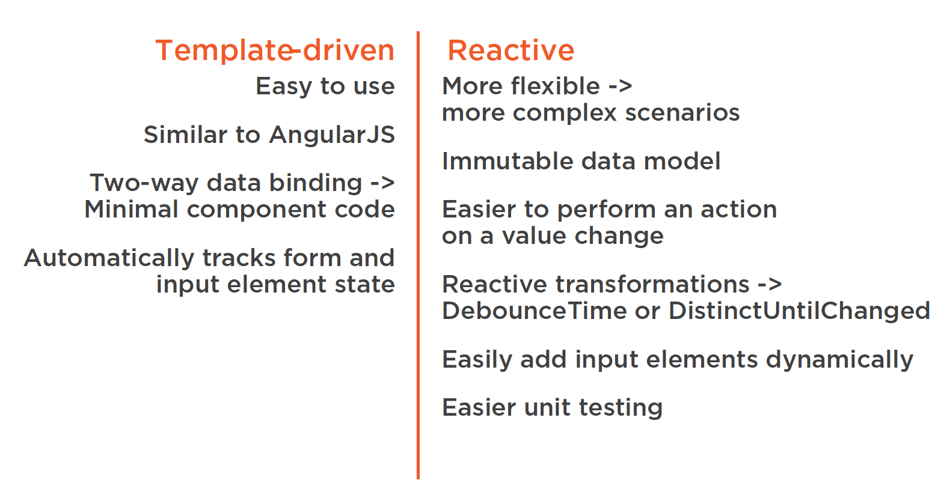
Template-driven vs. Reactive Forms

Slide 4
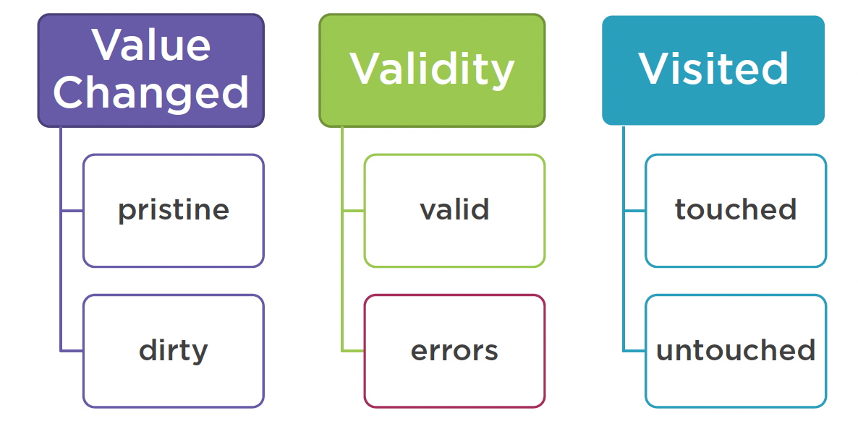
Form Building Blocks
  State

Slide 5
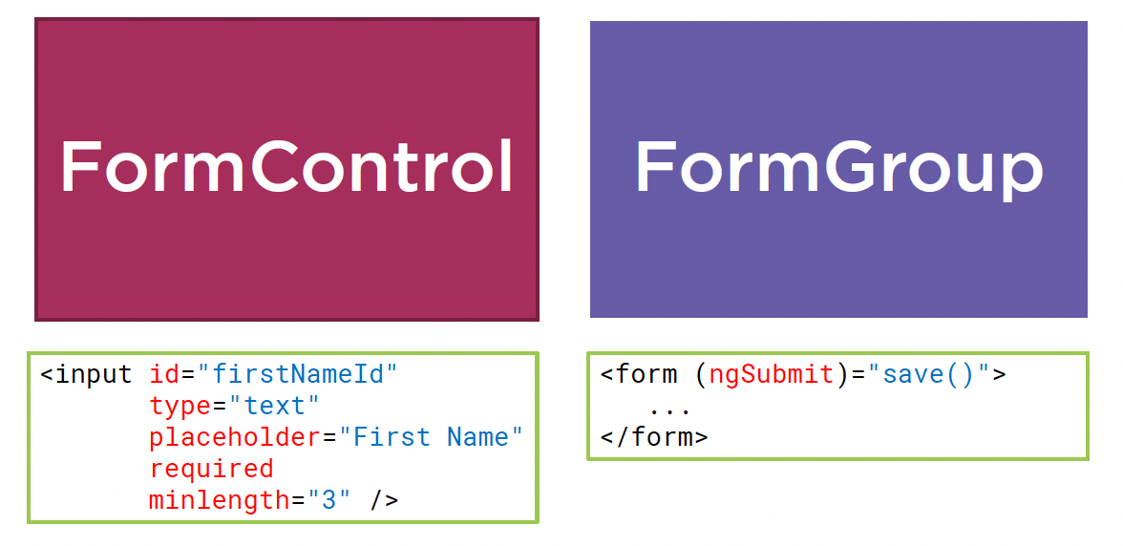
Form Building Blocks
  Form Building Blocks

Slide 6
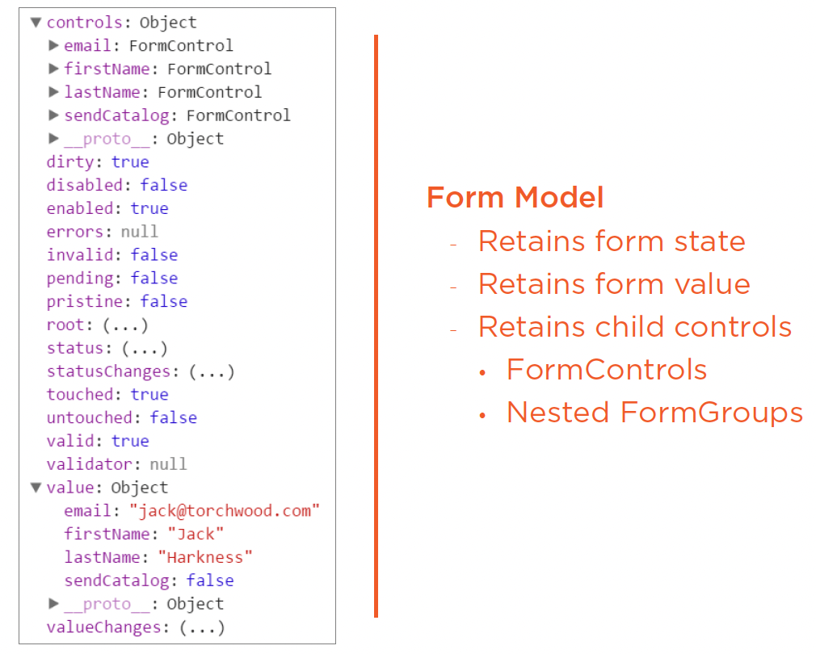
Form Building Blocks
  Form Model

Slide 7
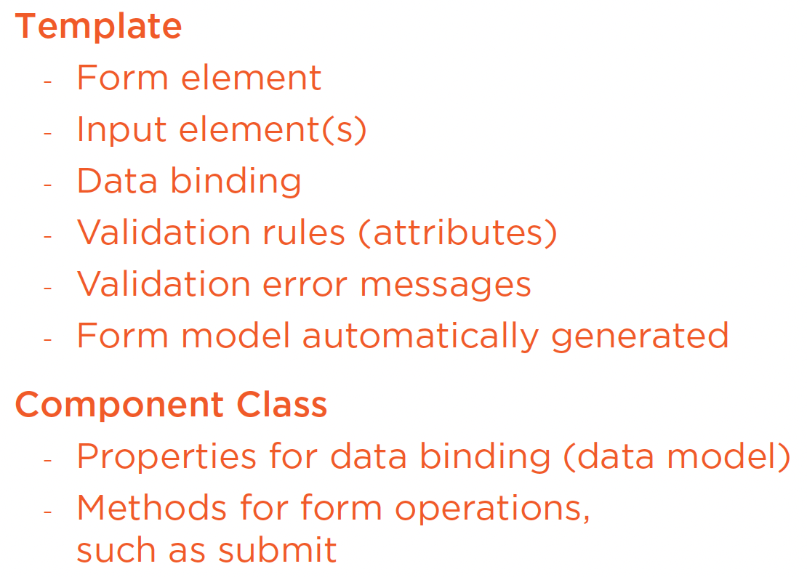
Form Building Blocks
  Template-driven Forms

Slide 8
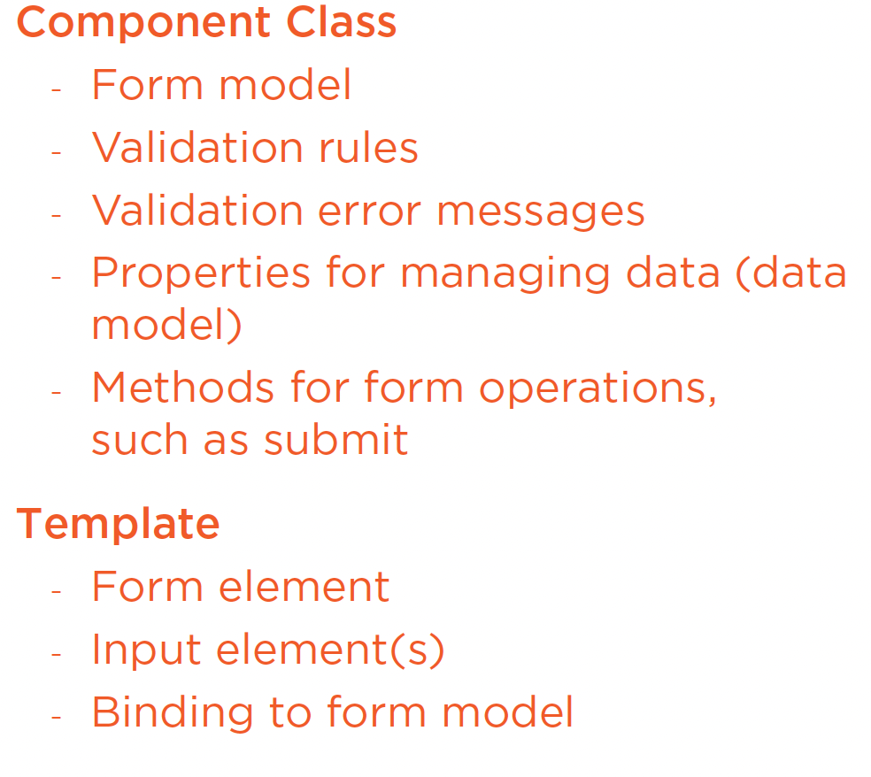
Form Building Blocks
  Reactive Forms

Slide 9
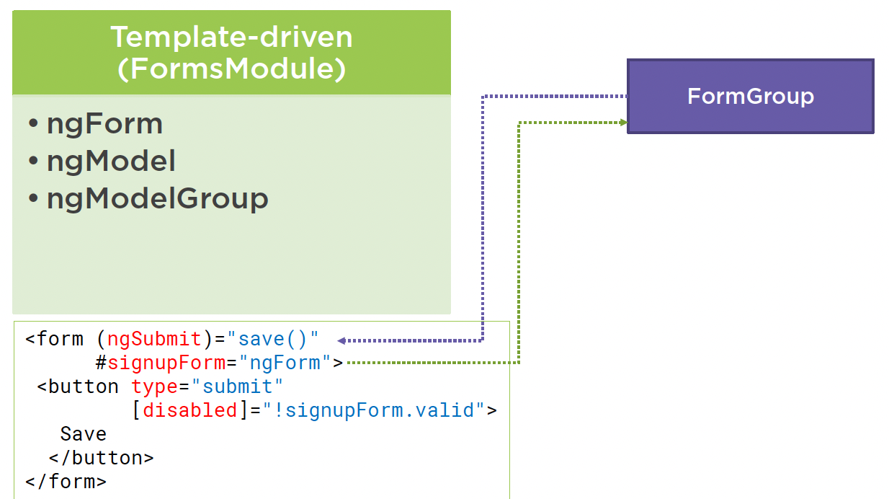
Form Building Blocks
  Template-driven Directives

Slide 10
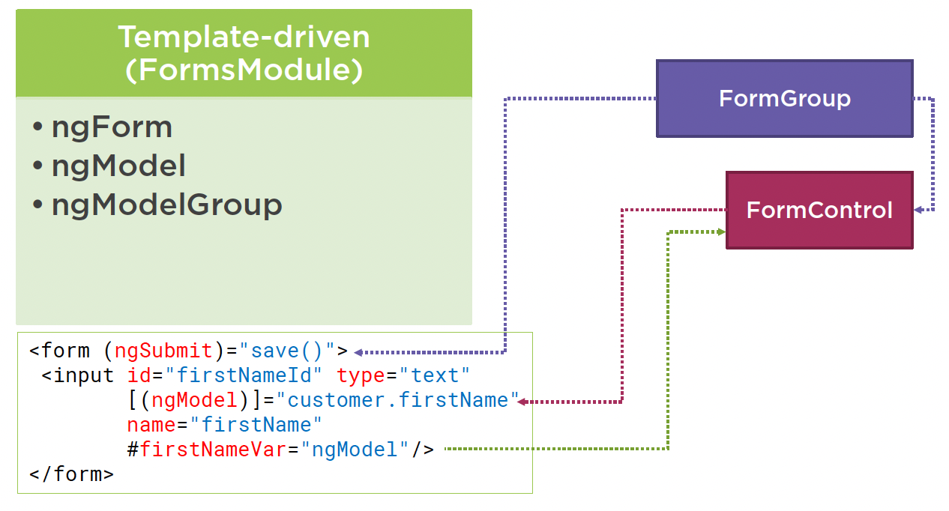
Form Building Blocks
  Template-driven Directives

Slide 11
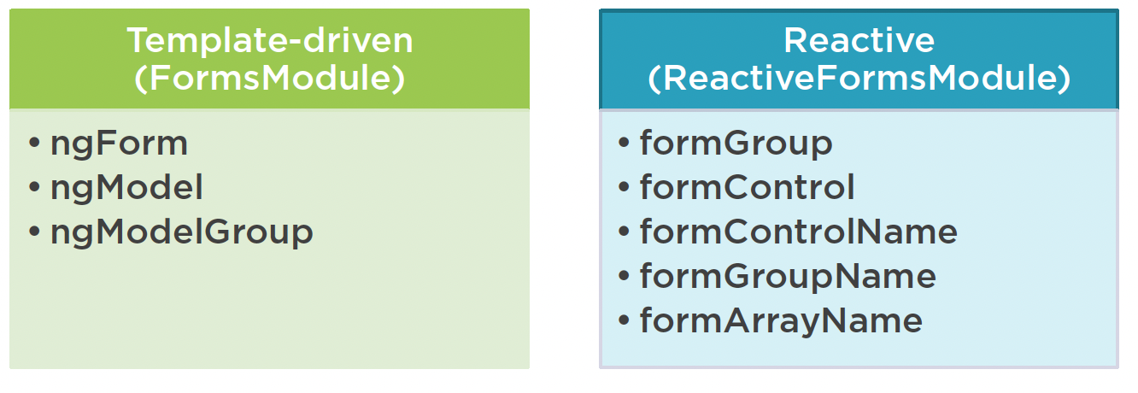
Form Building Blocks
  Directives

Slide 12
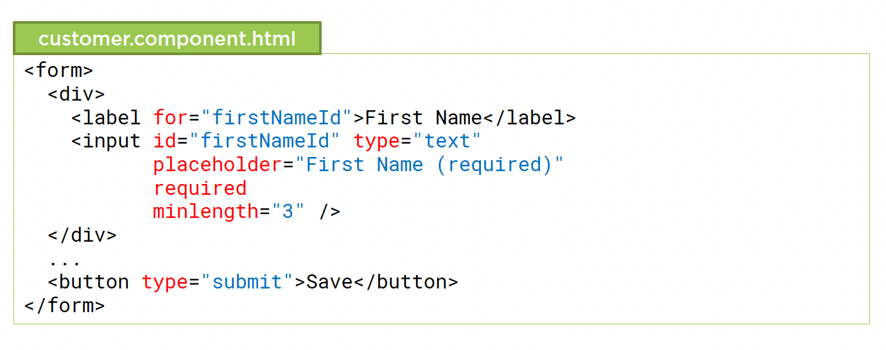
Template Syntax for Forms
  HTML Form

Slide 13
Summary

Slide 14
Assignment

Slide 15
Self Study
  Angular Routing
  https://app.pluralsight.com/library/courses/angular-routing

